Slide 1

Land-Use Land-Cover Classification by Machine Learning Classifiers for Satellite Observations
Prof :Shrinath Ghedam
Problem Statement: Knowledge of land-use/land-cover (LULC) change is
essential in a number of fields based on the use of Earth observations,
such as urban and regional planning environmental vulnerability
and impact assessment, natural disasters and hazards monitoring
Solutions: map LULC patterns and dynamics from the satellite observations, including
traditional terrestrial mapping, as well as satellite-based mapping.

Slide 2
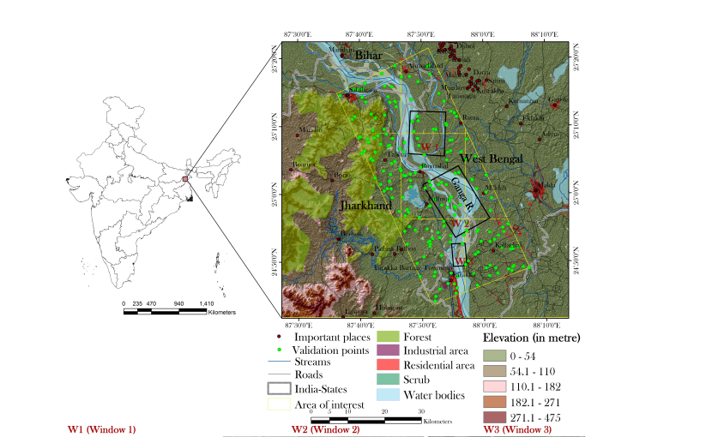
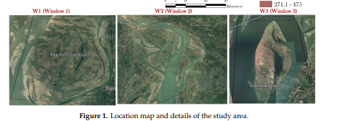
Dataset:
Landsat 8 Operational Land Imager (OLI) image Of Ganga region

Slide 3
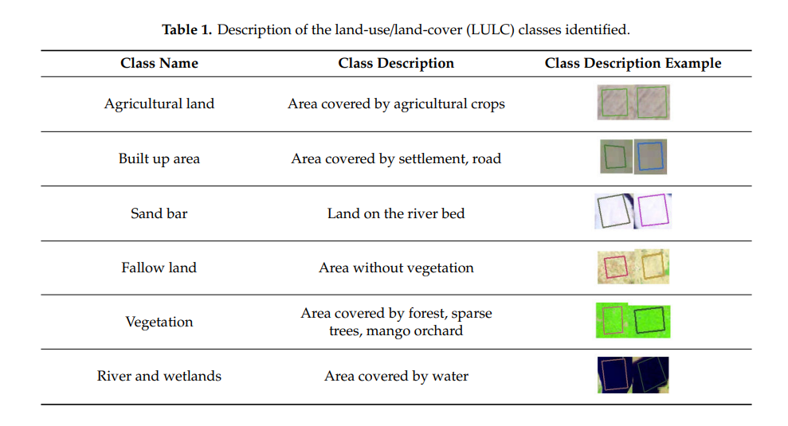
Description of the classes identified:

Slide 4
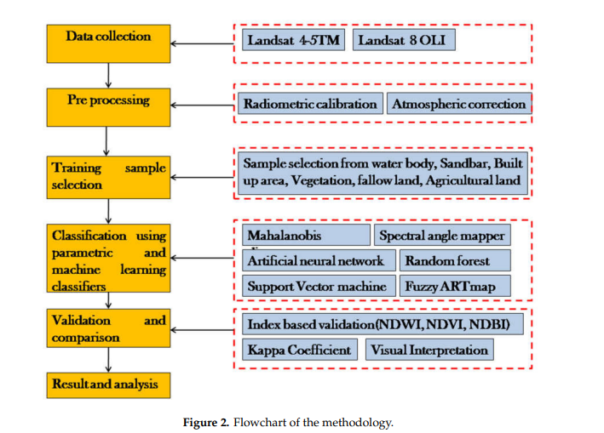
FLOWCHART:

Slide 5
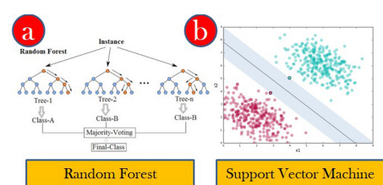
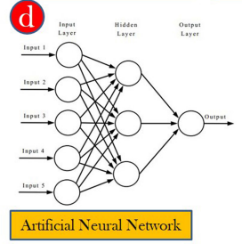
Algorithms applied for classification:

Slide 6
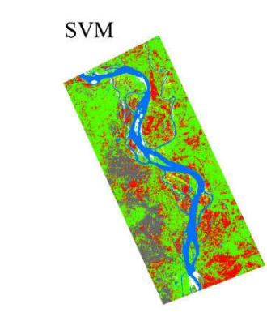
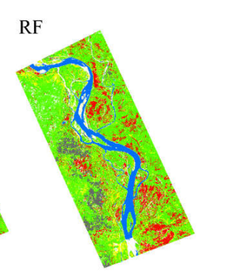
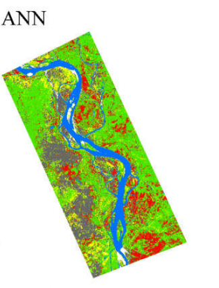
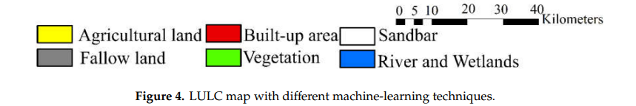
Results:

Slide 7
Conclusion:
RESULTS:Kappa Coefficient (k)
The aim was to suggest the best classifier. Three machine-learning algorithms were applied on the Landsat 8 (OLI) data for the LULC classification. Accuracy assessments were undertaken by using the Kappa coefficient, an index-based technique and empirical observations. Results suggest that the area under each LULC class varies under different classifiers.
The maximum variation is observed for the agricultural and fallow lands, while the minimum for the water bodies and wetlands. Such variation requires a need to prove the best suited classifier
.
ADVANTAGES OF LULC MAPPING
Target detection - identification of landing strips, roads, clearings, bridges, land/water interface
Natural resource management
Routing and logistics planning for seismic / exploration/resource extraction activities
DISADVANTAGES
Data preprocessing is difficult

